Slide 1


Pseudo-Class Variants in tailwind css

Slide 2
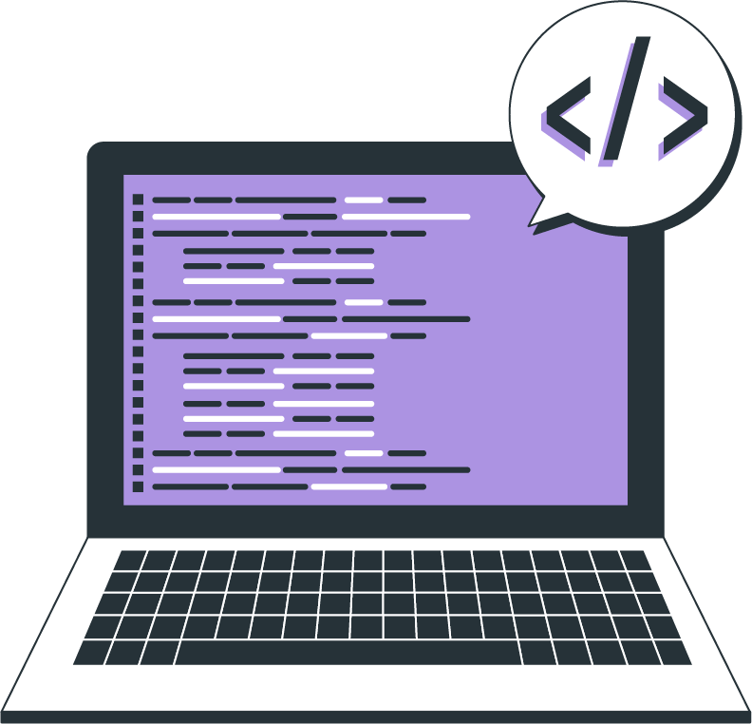
Topics
Introduction
Pseudo Classes

Slide 3
Introduction
Pseudo-class variants in Tailwind CSS allow you to apply styles to elements based on their state or interaction with the user For example, you can apply styles to links when they are hovered over, or to form elements when they are focused.

Slide 4


Pseudo Classes
Hover
The hover variant is used to apply styles when the user hovers over an element. To use this variant, simply prefix the utility class with hover:
Example:
<button class="bg-blue-500 hover:bg-red-700 text-white font-bold py-2 px-4 rounded">
Hover me!
</button>
OUTPUT:
Before Hover
After Hover

Slide 5


Pseudo Classes
Focus
The focus variant is used to apply styles when an element is focused, typically when a user clicks or tabs into an input field. To use this variant, prefix the utility class with focus:
Example:
<input class="border border-gray-300 focus:border-blue-500 focus:outline-none py-2 px-4 rounded" type="text" placeholder="Focus me!" >
OUTPUT:
Before Hover
After Hover

Slide 6


Pseudo Classes
Active
The active variant is used to apply styles when an element is in an active state, such as when a button is being clicked(on click down). To use this variant, prefix the utility class with active:
Example:
<button class="bg-blue-500 active:bg-green-900 text-white font-bold py-2 px-4 rounded">
OUTPUT:
Before Hover
After Hover

Slide 7

Pseudo Classes
Disabled
The disabled variant is used to apply styles when an element is disabled, such as a disabled input field or button. To use this variant, prefix the utility class with disabled:
Example:
<button class="bg-blue-500 text-white font-bold py-2 px-4 rounded disabled:bg-gray-300 disabled:cursor-not-allowed" disabled>
Disabled button
</button>
OUTPUT:

Slide 8
THANK YOU

